Slide 1

Natural Language Processing: Attention is All you Need
An Dinh, Kate Moreland
Orginial research paper by Ashish Vaswani et al.

Slide 2
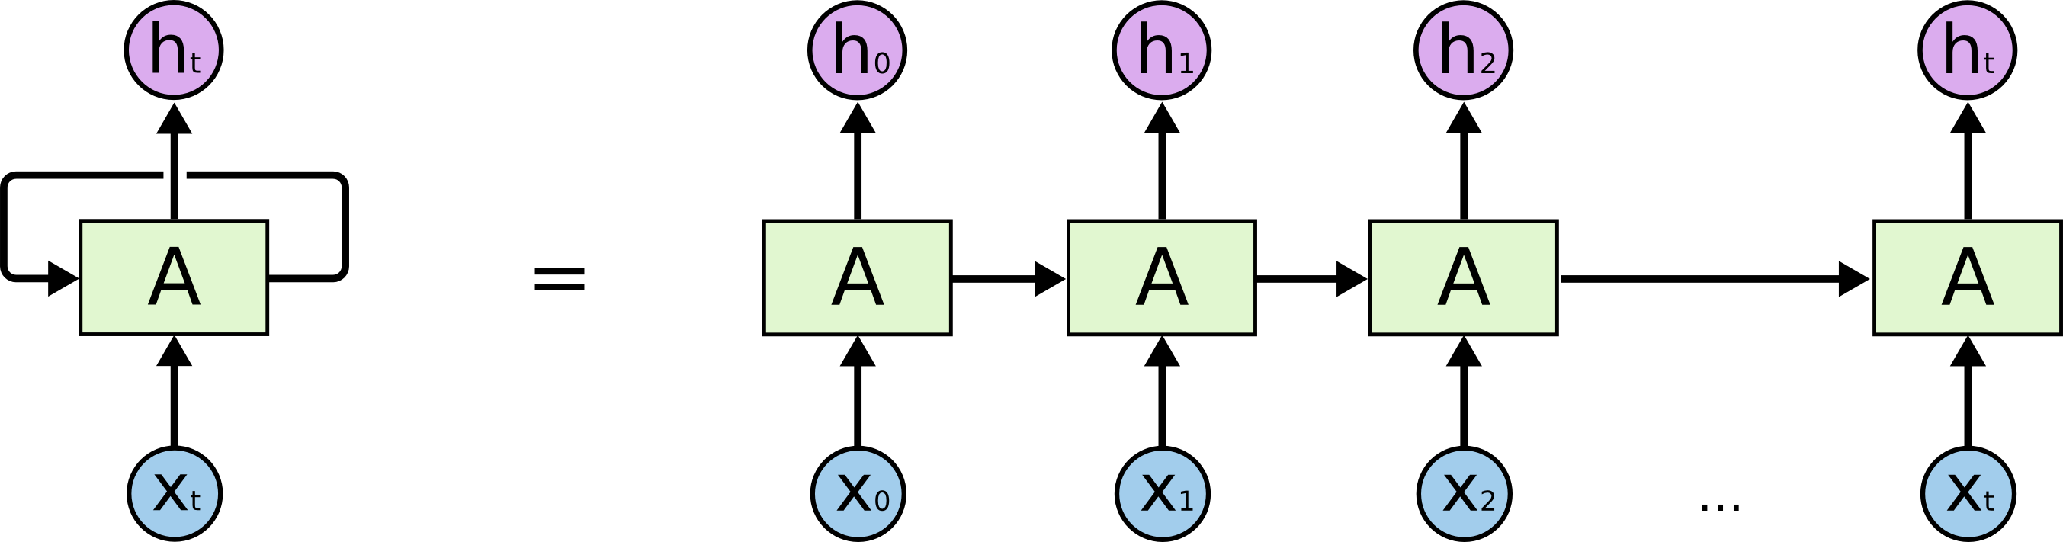
Problem proposed
Recurrent Neural Network (RNN) – map 1 sequence of input to another sequence of output
Problems:
Slow computation for long sequence
Vanishing and exploding gradients
Difficulty in accessing information from long time ago
➔ The need of Transformer Model
Notes:
An
RNN splits the sequence into single items and take step by step with hidden step in between, in other words, if there is n tokens, it will take n time step to end, which raise the problems of…
Explode- affect the speed of process
Long sequence = long chain, for instance, RNN cannot map every token since for example, the last token cannot depend on the first as there are many hidden steps in between

Slide 3
Main ideas of the algorithm
Reduce the number of operations by averaging attention-weighted positions using the Multi-Head Attention Mechanism
“The first sequence transduction model based entirely on attention, replacing the recurrent layers most commonly used in encoder-decoder architectures with multi-headed self-attention.”
Notes:
An
Not all languages follow the same grammar pattern →track relationships in sequential data like words in sentence = solve the problem of sequence transduction or machine translation

Slide 4

Configuration of the experiment environment
Model Architecture: Transformer model
Training Data: WMT 2014 English-to-German parallel corpus
Preprocessing: Tokenization and batching of sentences
Training Procedure: Adam optimizer
Hardware: NVIDIA P100 GPUs
Hyperparameters: Specific values
Notes:
Kate
Model Architecture – with a specific configuration of layers, attention heads, and hidden units
Training Data – consisting of sentence pairs for training
Preprocessing
Training Procedure – with a custom learning rate schedule and label smoothing
Hardware – used for training
Hyperparameters – for learning rate, dropout rate, batch size, etc.
Adam optimizer: $β$1 = 0:9, $β$2 = 0:98 and $𝔢$= 10, warmup_steps = 4000

Slide 5
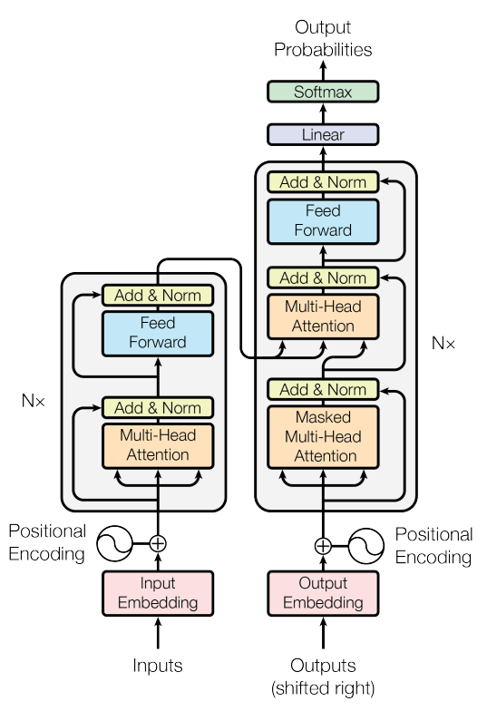
Main steps of the algorithm
Encoder-Decoder Stacking:
Multiple layers of the transform model are stacked to form this. The encoder processes the input sequence and the decode generates the output sequence.
Decoder
Encoder
Notes:
An

Slide 6
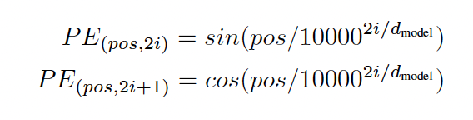
Encoder
Input Embedding:
Converting sequences in vectors
Positional Encoding:
Needs a way to order input tokens
Notes:
Kate

Slide 7
Encoder
Multi-Head Attention Mechanism:
Computes attention over to input sequences, it involves many steps.
It is then repeated multiple times with different learned linear transformations of input vectors.
Notes:
Kate

Slide 8
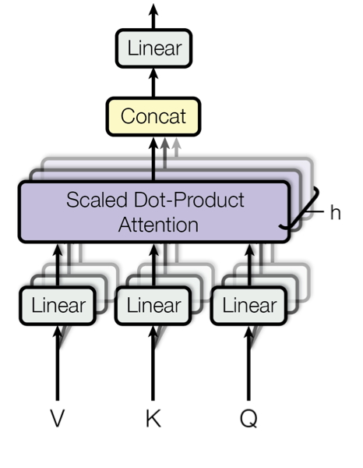
Multi-Head Attention Mechanism
Query, Key, and Value Transformation:
Linearly changed into query, key, and value vectors, learned during training
Scaled Dot-Product Attention:
Attention scores are calculated. They are then scaled to prevent gradients from being too small.
Notes:
Kate

Slide 9
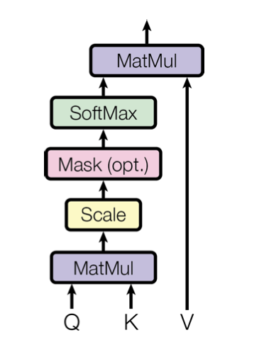
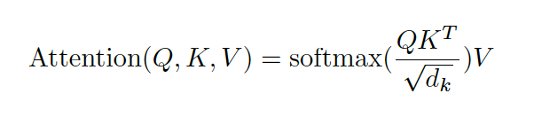
Multi-Head Attention Mechanism
Attention Weights and Context Vector:
The attention scores are put through softmax function. The weights are used to calculate a weighted sum of value vectors.
Notes:
Kate

Slide 10

Encoder
Position-Wise-Feed-Forward Networks:
Each token's representation is put through a position-wise feed-forward network.
Notes:
Kate

Slide 11
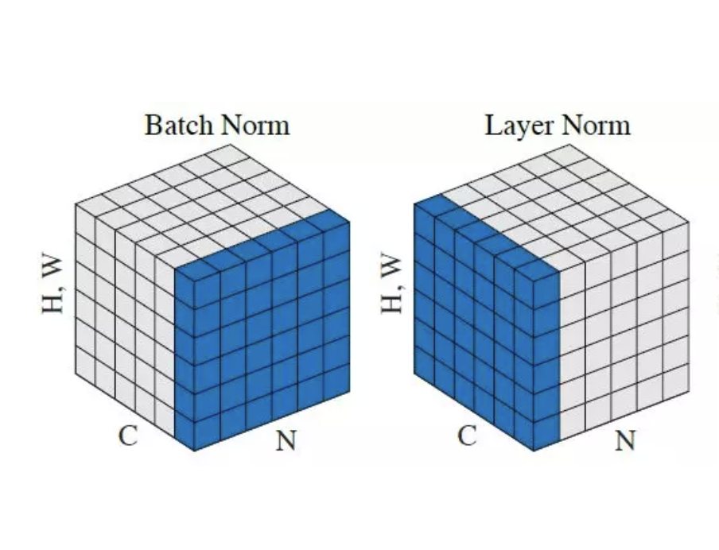
Encoder
Layer Normalization and Residual Connection:
It normalizes the activations of each layer and stabilizes the training process.
Notes:
An
Position-Wise: Consists of two linear transformation
Difference between batch norm and layer norm is (how layer norm works)
Batch norm- same features for all the batch → missing values from different item of the batch
Layer norm- compare all values belong to 1 item in a batch, treat item in a batch independently
D_{model}= 512

Slide 12
Decoder
Decoder Layer and Masked Multi-Head Attention:
The decoder employs a masked multi-head attention mechanism during self-attention.
Notes:
An
The goal is to make the output a certain position can only depend on the words on the previous positions
Masked multi-head prevents the decoder from going to future tokens in training

Slide 13
Decoder
Final Linear Transformation and Softmax:
The output of the decoder is linearly transformed into a vector.
It is then passed through a softmax function.
ENCODER
Notes:
An
It has the same dimension as the vocabulary size.
This gets the probability distribution over the vocabulary.
The output from the encoder will come in the form of query and value so the decoder can take those as its input of the multi-head attention (the third sub-layer compared to the number of layers encoder has)

Slide 14
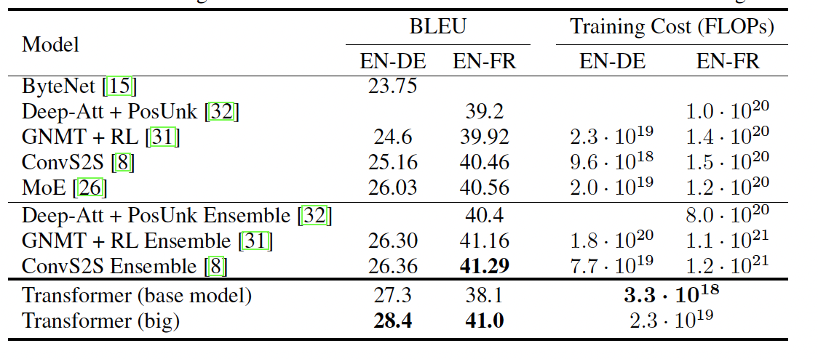
Result and analysis
It achieved state-of-the-art performance on multiple benchmarks.
Inherent parallelization allows for parallel computation across tokens in the input sequence.
It showed robust performance across a wide range of sequence lengths.
It generalized well to multiple natural language processing tasks.
Notes:
Kate
Benchmarks (WMT 2014 English-to-German and English-to-French)
- BLEU (Bilingual Evaluation Understudy) score of 28.4 and 41.0 (shown in the table) outperforms the best previously models
Means faster training times, which makes it more scalable and efficient
Model could capture the order of the tokens in the input sequence
Tasks such as (text classification, language modeling, and question answering)

Slide 15
Strong points
Utilizing self-attention exclusively without employing sequence-aligned RNNs
Offering greater parallelizability than traditional models
Scaling effectively to longer sequences, making it suitable for processing long sentences
Providing ease of Interpretability
Notes:
An

Slide 16
Potential weak points
Might be struggle with tasks involving output prediction or where order matters.
Requires a large amount of data to train
Necessitates a significant amount of computational resources and expertise for hyperparameter tuning → expensive for long sequences
Lacks an external memory mechanism
Notes:
Kate

Slide 17
Conclusion
First sequence Transduction based on attention
Outperforms other models based on recurrent or convolutional layers for translation task
Impacts the field of AI
Future plan to extend the transformer
Notes:
An & Kate (half- half)

Slide 18
References
Ashish Vaswani, Noam Shazeer, Niki Parmar, Jakob Uskoreit, Llion Jones, Aiden N.Gomez, Lukasz Kaiser. (2017). Attention is All You Need. https://arxiv.org/pdf/1706.03762.pdf
Yannic Kilcher. (2017). Attention is All You Need. https://www.youtube.com/watch?v=iDulhoQ2pro.
Amazon Web Services. (n.d.). Recurrent neural network (RNN). Retrieved from https://aws.amazon.com/what-is/recurrent-neural-network/#:~:text=A%20recurrent%20neural%20network%20(RNN,complex%20semantics%20and%20syntax%20rules
Amazon Web Services. What are Transformers in Artificial Intelligence? Retrieved from https://aws.amazon.com/what-is/transformers-in-artificial-intelligence/#:~:text=Transformers%20have%20created%20a%20new,applications%20that%20solve%20innovative%20problems.

